Slide 1
SWE 4101
Hardware Components
&
Peripherals
Lec - 2

Slide 2
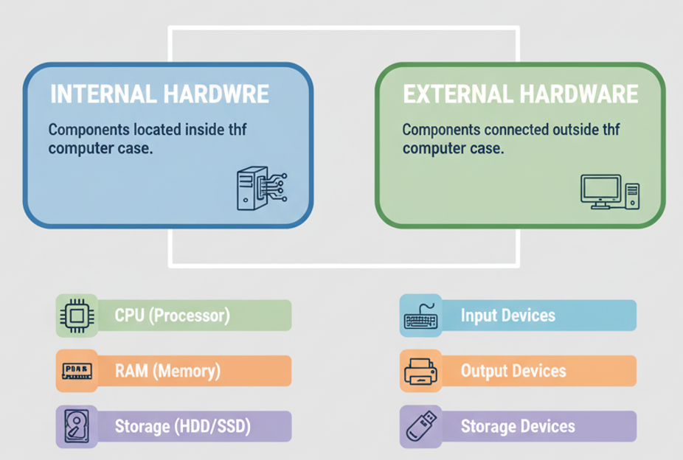
What is Computer Hardware
Hardware is the physical, tangible parts of a computer system that you can touch.

Slide 3
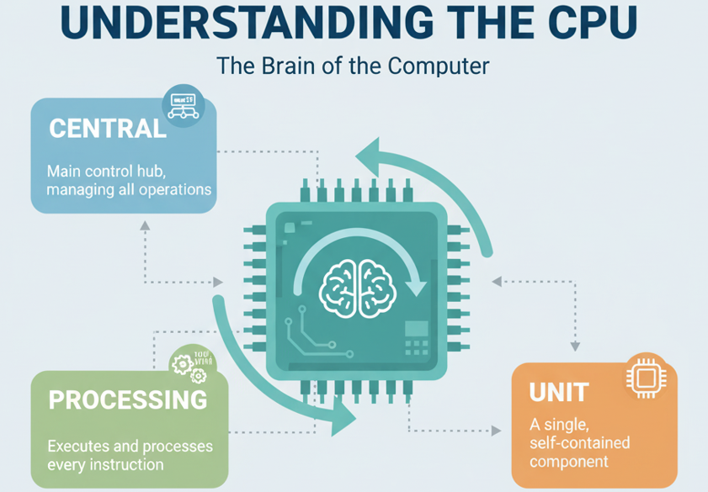
CPU (Central Processing Unit)
computer’s brain. The CPU was invented by Intel in 1971.
handles all the tasks you tell the computer to do, like opening a game or writing a document.

Slide 4




CPU (Central Processing Unit)
How it works?
FETCH
DECODE
EXECUTE
STORE
The CPU collects instructions from the system’s memory.
It changes those instructions into easy-to-follow steps.
The CPU performs the action, such as solving math or moving information.
The output is kept in memory so it can be used later when required.

Slide 5
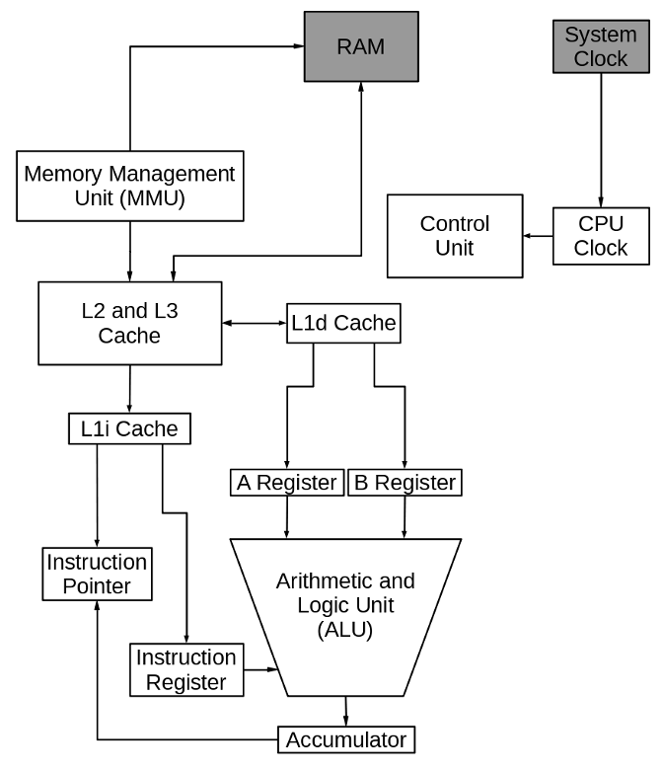
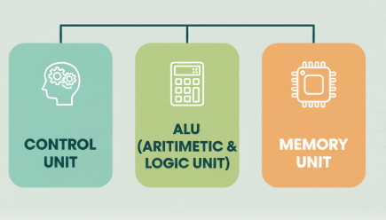
CPU (Central Processing Unit)
Parts of CPU
Control Unit (CU): Directs the flow of instructions and data within the computer.
Arithmetic Logic Unit (ALU): Performs calculations and logical operations.
Registers: Small, high-speed storage locations for temporarily holding data.
Cache Memory: Extremely fast memory that provides rapid access to frequently used data and instructions.
Buses: Pathways that carry data and signals between various parts of the computer.
Source: https://www.redhat.com/

Slide 6
Working Procedure
Let’s add two numbers , example : 5 + 3.
Component | Action | Value / Example
RAM | Stores instructions and data | LOAD A,5, LOAD B,3, ADD A,B
MMU | Maps virtual → physical addresses | 0x01 → 0x101
Cache (L1/L2/L3) | Holds frequently used instructions/data | LOAD A,5
Instruction Pointer | Points to next instruction | 0x01 → 0x02
Instruction Register | Holds current instruction | LOAD A,5
A Register | Holds first operand | 5
B Register | Holds second operand | 3
ALU | Performs arithmetic/logic | 5 + 3 = 8
Accumulator | Stores result | 8
Source: https://www.redhat.com/

Slide 7
CPU (Central Processing Unit)
Types of CPU
General Purpose CPU : A CPU designed to handle a wide variety of tasks and applications, not limited to a specific function. For example Intel Core i7, AMD Ryzen 7.
Based on purpose
Special Purpose CPU : A CPU designed for a specific task or application, optimized for that function rather than general use. GPU processors in graphics cards (like NVIDIA RTX) for rendering graphics, or microcontrollers in washing machines.
CISC (Complex Instruction Set Computer): A CPU architecture with a large set of instructions, allowing a single instruction to execute multiple low-level operations. Intel x86 processors — one instruction can move, add, and store data in a single command
Based on Architecture
RISC (Reduced Instruction Set Computer): A CPU architecture with a small set of simple instructions that execute very quickly, often requiring multiple instructions for complex tasks. ARM processors in smartphones (like Apple M1, Qualcomm Snapdragon).
Single-Core CPU: A CPU with only one processing unit (core) that can execute one instruction at a time. Early Intel Pentium 4 processors.
Based on Core
Multi-Core CPU: A CPU with two or more cores, allowing it to execute multiple instructions simultaneously, improving multitasking and performance. Intel Core i9 (8-core/16-thread), AMD Ryzen 9 (12-core/24-thread).

Slide 8
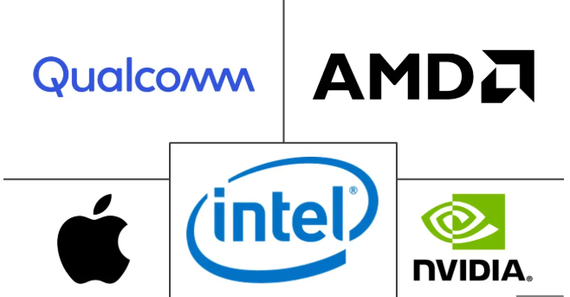
CPU (Central Processing Unit)
Major CPU Manufacturers

Slide 9
Memory Unit
One of the most vital components of a computer system.
Without memory, a computer would not be able to perform even the simplest tasks.
Understanding Memory Units
The storage capacity of computer memory is measured in bytes.
Each byte consists of 8 bits, and each bit represents a binary value—either 0 or 1.
The standard memory units are as follows:
Unit | Symbol | Equivalent
Bit | b | Smallest unit of data (0 or 1)
Byte | B | 8 bits
Kilobyte | KB | 1,024 bytes
Megabyte | MB | 1,024 KB
Gigabyte | GB | 1,024 MB
Terabyte | TB | 1,024 GB
Petabyte | PB | 1,024 TB
Exabyte | EB | 1,024 PB

Slide 10
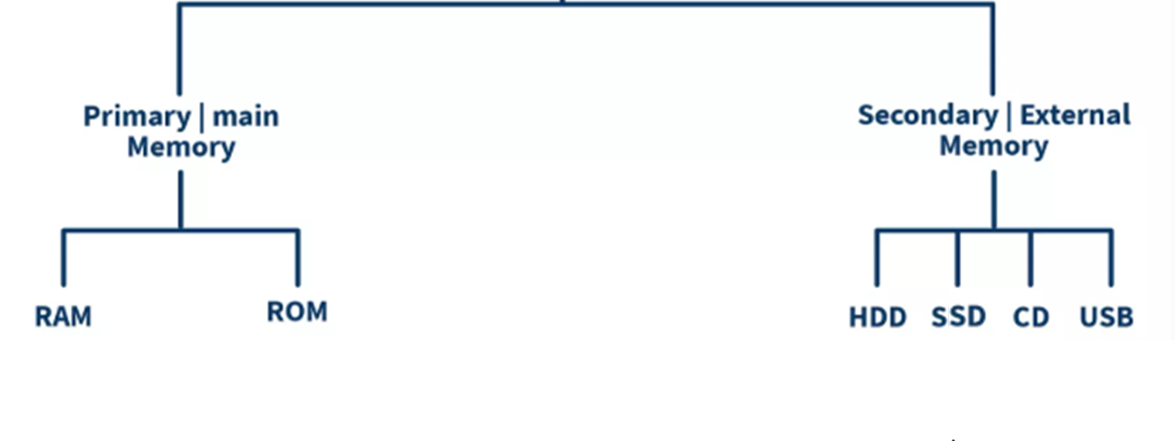
Memory Unit
Types of Computer Memory

Slide 11
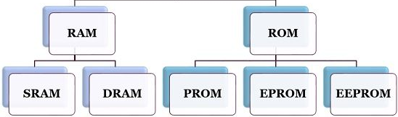


Memory Unit
Primary Memory
RAM stands for Random Access Memory, and it stores data temporarily while the computer is in use.
It helps the computer remember what you are doing at the moment.
Volatile (loses data when powered off)
How does RAM work?
You turn on your computer, and important files load into RAM.
When you open an app, RAM stores it for quick access and sends data to the CPU for processing.
As you open more apps, RAM divides its space among them.
Once you close the app or shut down the computer, everything in RAM is erased.

Slide 12
Memory Unit
Primary Memory (RAM)
Static RAM (SRAM)
SRAM is a high-speed type of memory that doesn’t need constant refreshing.
  Stores data as long as power is supplied
  Operates very fast
  More expensive than other types of RAM
  Commonly used in small amounts, such as in cache memory
Dynamic RAM (DRAM)
DRAM is the most widely used type of RAM that constantly refreshes its data.
  Holds data only for a short time
  Requires continuous refreshing
  Slower than SRAM
  Less expensive and used as the main memory in most computers
DDR RAM (Double Data Rate RAM)
DDR RAM is an improved version of DRAM that operates at higher speed and efficiency.
Different versions of DDR RAM:
      DDR1: Oldest and slowest version
      DDR2: Faster and more efficient than DDR1
      DDR3: Common in older computers and laptops
      DDR4: Very fast and widely used in modern systems
      DDR5: Latest and fastest version designed for advanced computers

Slide 13

Memory Unit
Primary Memory (RAM)
How Much RAM Do You Need?
  The amount of RAM you need depends on your usage.
  Having more RAM makes your computer run faster and more smoothly.
You have multiple browser tabs, a video editing software, and a music player running at the same time. Suddenly, your computer freezes and takes a long time to respond.
Why did this happen?

Slide 14
Memory Unit
Primary Memory (ROM)
Read-only memory (ROM), is a type of non-volatile memory in a computer, which means the data stored in it remains even when the power is turned off.
primarily used to store permanent instructions that the computer needs to start and operate, such as the BIOS or firmware.
PROM (Programmable ROM)
A type of ROM that can be programmed only once after manufacturing.
  Once written, the data cannot be changed
Example: Used in electronic devices where permanent instructions are needed, like calculators or microwave controllers.
EPROM (Erasable Programmable ROM)
A type of ROM that can be erased and reprogrammed.
  Data is erased using ultraviolet (UV) light
  Can be reprogrammed multiple times
Example: Used in BIOS chips of computers in earlier days
EEPROM (Electrically Erasable Programmable ROM)
A type of ROM that can be erased and reprogrammed electrically without removing it from the system.
  Data is erased using electrical signals
  Can be rewritten multiple times
Example: Modern BIOS chips, memory cards, and embedded systems

Slide 15
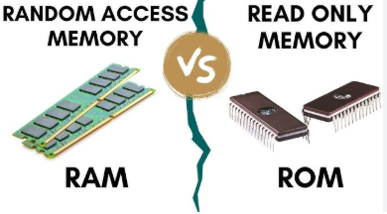
RAM vs ROM
Feature | RAM (Random Access Memory) | ROM (Read-Only Memory)
Type of Memory | Volatile | Non-volatile
Data Loss | Data is lost when power is off | Data remains safe
Use | Temporary storage | Permanent instructions
Speed | Very fast | Slower than RAM
Editable | Can be changed | Cannot be easily changed
Storage Capacity | High | Low
Cost | Expensive | Cheaper
Working Stage | Active during processing | Active during booting
Example | DDR4, DDR5 | BIOS, Firmware

Slide 16
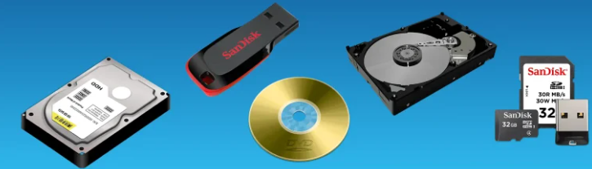
Memory Unit
Secondary Memory
Secondary storage refers to non-volatile storage devices that hold data permanently.
keeps data for a long time without the need for a continuous power source.
Importance of Storage Devices
  Provide permanent storage for data
  Allow storage of large volumes of information
  Serve as a backup solution
  Enable data recovery in case of system failures
  Facilitate file sharing and data transfer
Categories of Secondary Storage Devices
Category | Examples | Speed | Portability | Use Case
Magnetic Storage | HDD, Tape Drives | Moderate | Low | Long-term storage
Solid-State Storage | SSD, USB Drives | High | High | Fast data access
Optical Storage | CDs, DVDs, Blu-rays | Low | Moderate | Media storage
Cloud Storage | Google Drive, Dropbox | High | Very High | Remote backups

Slide 17
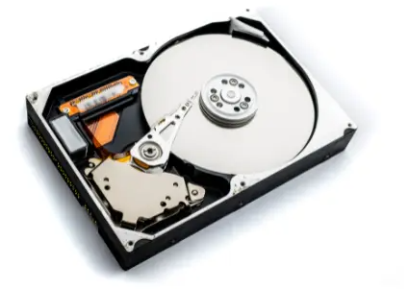
Memory Unit
Secondary Memory (HDD)
A hard disk drive is used to store a large amount of data.
HDD is a type of magnetic storage device.
Key Features of HDD:
  Stores large amounts of data (500 GB, 1 TB, or more)
  Non-volatile; retains data without power
  Contains moving parts (spinning disks)
  Uses magnetic storage technology
  Installed inside the computer case
  Slower than SSD
  Low-cost storage option

Slide 18
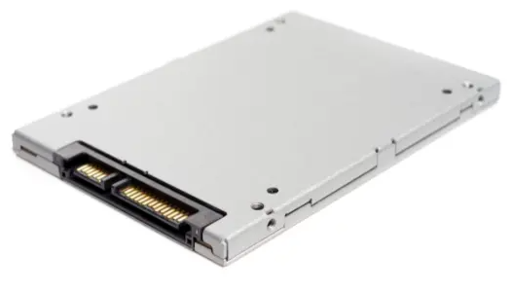
Memory Unit
Secondary Memory (SSD)
A solid-state drive stores data in a fast way.
It has no moving parts. It works silently and quickly.
Key Features of SSD:
  Stores large data (256 GB, 512 GB, 1 TB)
  Non-volatile; retains data without power
  Uses flash memory for storage
  Faster than HDD
  Energy-efficient; saves laptop battery
  Lightweight and compact
  Silent operation (no moving parts)

Slide 19
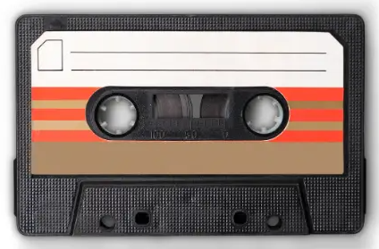
Memory Unit
Secondary Memory (Magnetic Tape)
A magnetic tape stores data on a long plastic strip.
It looks like the tape inside a cassette.
Can save a lot of data for a long time. slow but cheap.
Industries use it to keep backup files.
Key Features of Magnetic Tape:
  Stores very large data (multiple terabytes)
  Non-volatile; retains data without power
  Sequential data storage (one after another)
  Slow read/write speed
  Low-cost for long-term storage
  Portable and easy to carry
  Requires a tape drive to read/write
  Type of magnetic storage device

Slide 20
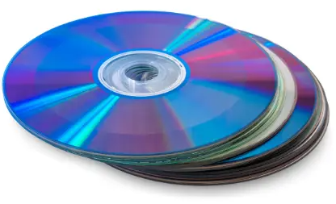
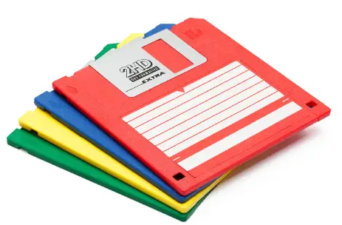
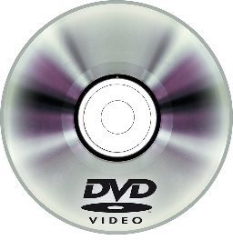
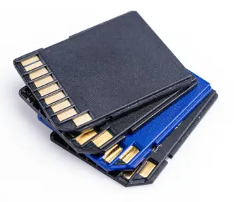
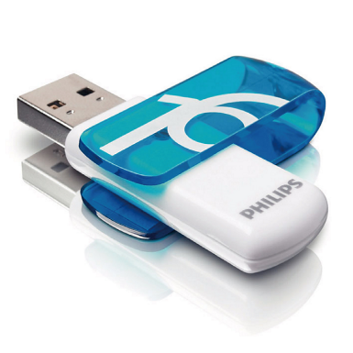
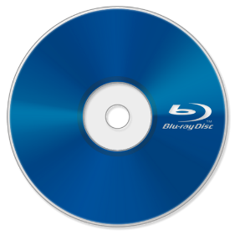
Memory Unit
Secondary Memory (Others)
Compact Disc (CD):
Stores up to 700 MB, non-volatile
Uses laser (optical) storage
Lightweight and portable
Requires CD drive
Low-cost storage option
Floppy Disk:
Stores 1.44 MB, magnetic storage
Lightweight and portable
Slow read/write, requires floppy drive
Obsolete; replaced by better devices
SD Card:
Stores data from a few MB to 1 TB+
Non-volatile; retains data without power
No moving parts; silent operation
Small and lightweight
Used in phones, cameras, tablets
Removable and reusable
Faster read/write than CDs/DVDs
DVD:
Stores 4.7–8.5 GB, non-volatile
Optical storage for videos, software, files
Lightweight and portable
Requires DVD drive
Rewritable DVDs (DVD-RW) are reusable and cheap
USB Flash Drive:
Stores data from 2 GB to 1 TB+
No moving parts; durable
Uses solid-state storage
Fast data transfer
Reusable; can delete and save data multiple times
Connects via USB
Blu-ray Disc:
Stores 25 GB (single layer) or 50 GB (dual layer)
Non-volatile; retains data without power
Uses blue laser for reading/writing
Better picture and sound than DVD
Lightweight, portable, and scratch-resistant
Works only in Blu-ray players or drives

Slide 21
Memory Unit
Cache Memory
Cache is the temporary memory officially termed “CPU cache memory.”
is a high‑speed memory location built into or very close to a computer’s processor.
stores copies of frequently used data and instructions so that the CPU can access them much more quickly than if it had to fetch them from main memory (RAM) or from disk.
Why Cache Matters (Performance Impact)
When the CPU needs to access data, it checks the cache first.
If the data is found (“cache hit”), the access is extremely fast.
If it’s not found (“cache miss”), the system must fetch it from slower memory or storage which delays performance.
Levels of Cache
Modern CPUs typically implement multiple cache levels to balance speed and size:
  L1 Cache: The smallest and fastest—built directly into the CPU. It holds the data most likely to be used next.
  L2 Cache: A larger but slightly slower cache that the CPU checks if data isn’t found in L1.
  L3 and beyond / Other caches: Some systems include L3 or even L4. There is also disk cache (on hard drives/SSDs) and GPU cache in graphics systems.
When you’re buying or evaluating a computer, cache is one of many specs—but not always the most visible or advertised.
  Cache size: A larger cache can hold more data, but may also have higher latency (slower access).
  Latency/speed: The access speed of the cache matters more than size.

Slide 22
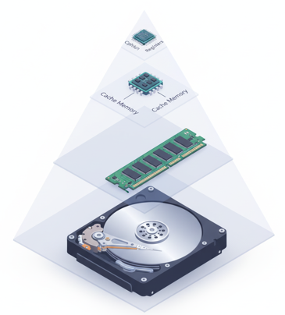
Memory Unit
Register
are a type of computer memory built directly into the processor or CPU (Central Processing Unit)
is used to store and manipulate data during the execution of instructions.
stores copies of frequently used data and instructions so that the CPU can access them much more quickly than if it had to fetch them from main memory (RAM) or from disk.
Memory Hierarchy
Low
High
Storage Capacity
Access Speed
High
Low

Slide 23
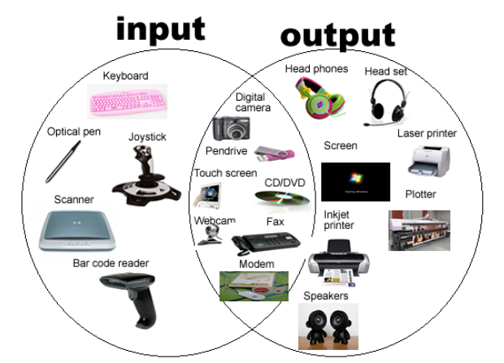
Input/Output Devices
Input Device: Hardware used to enter data into a computer, e.g., keyboard, mouse.
Output Device: Hardware that displays or produces the result of processed data, e.g., monitor, printer.

Slide 24
Assignment: Input and Output Devices
Objective:
Understand the different types of input and output devices, their functions, working principles, and importance in computer systems.
Instructions:
List at least 5 input devices and 5 output devices.
For each device, provide the following details:
  Device Name
  Type (Input/Output)
  Function / Purpose
  How it works (brief explanation)
  Example Usage (where it is commonly used)
  Additional Info (optional, e.g., advantages, limitations, special features)
Submission deadline:

